Slide 1
Intravenous Ketamine Infusions for Acute Pain Management
Collective review
R2สุพฤกษ์ / อ.ปรีชา

Slide 2
Schwenk, E. et al. (2018). Consensus Guidelines on the Use of Intravenous Ketamine Infusions for Acute Pain Management From the American Society of Regional Anesthesia and Pain Medicine, the American Academy of Pain Medicine, and the American Society of Anesthesiologists. Regional Anesthesia And Pain Medicine
Notes:
To date, few recommendations are available to guide this emerging acute pain therapy. The variability in patient selection, drug dosing, monitoring, and management protocols speaks to the need for guidance. The purpose of these guidelines is therefore to provide a framework for safe use of ketamine in the acute pain setting.

Slide 3
Outline
Introduction
Indications for use
Dosing
Adjunctive therapies for perioperative analgesia
Contraindications
Nonparenteral ketamine
Patient-controlled IV ketamine analgesia

Slide 4
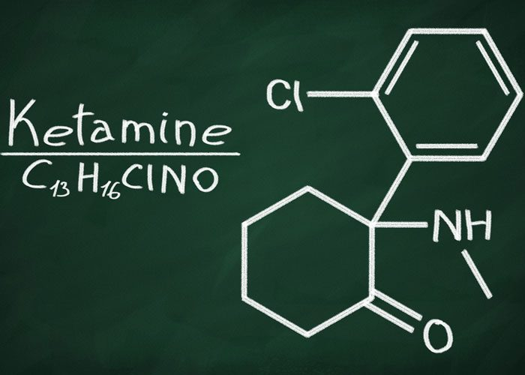
Introduction
Ketamine was synthesized in 1962 by Stevens
First used in humans in 1965 by Corssen and Domino

Slide 5
Introduction
The use of ketamine in subanesthetic concentrations for analgesia and other indications has exploded recently
Ketamine is increasingly being administered in inpatient settings with acute pain service guidance and in outpatient settings under a variety of models
Schwenk, E. et al. (2018). Consensus Guidelines on the Use of Intravenous Ketamine Infusions for Acute Pain Management From the American Society of Regional Anesthesia and Pain Medicine, the American Academy of Pain Medicine, and the American Society of Anesthesiologists. Regional Anesthesia And Pain Medicine

Slide 6
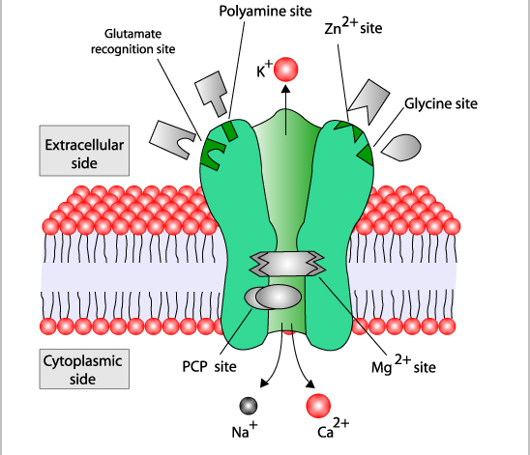
Introduction
Ketamine's analgesic properties in acute pain likely derive from its reversible antagonism of the N-methyl-D-aspartate receptor
Schwenk, E. et al. (2018). Consensus Guidelines on the Use of Intravenous Ketamine Infusions for Acute Pain Management From the American Society of Regional Anesthesia and Pain Medicine, the American Academy of Pain Medicine, and the American Society of Anesthesiologists. Regional Anesthesia And Pain Medicine

Slide 7
Introduction
μ-opioid receptor
muscarinic receptor
monoaminergic receptor
γ-aminobutyric acid receptor
Schwenk, E. et al. (2018). Consensus Guidelines on the Use of Intravenous Ketamine Infusions for Acute Pain Management From the American Society of Regional Anesthesia and Pain Medicine, the American Academy of Pain Medicine, and the American Society of Anesthesiologists. Regional Anesthesia And Pain Medicine

Slide 8
Notes:
To date, few recommendations are available to guide this emerging acute pain therapy. The variability in patient selection, drug dosing, monitoring, and management protocols speaks to the need for guidance. The purpose of these guidelines is therefore to provide a framework for safe use of ketamine in the acute pain setting.

Slide 9
Schwenk, E. et al. (2018). Consensus Guidelines on the Use of Intravenous Ketamine Infusions for Acute Pain Management From the American Society of Regional Anesthesia and Pain Medicine, the American Academy of Pain Medicine, and the American Society of Anesthesiologists. Regional Anesthesia And Pain Medicine

Slide 10
Schwenk, E. et al. (2018). Consensus Guidelines on the Use of Intravenous Ketamine Infusions for Acute Pain Management From the American Society of Regional Anesthesia and Pain Medicine, the American Academy of Pain Medicine, and the American Society of Anesthesiologists. Regional Anesthesia And Pain Medicine

Slide 11
Which Patients and Acute Pain Conditions Should Be Considered for Ketamine Treatment?

Slide 12
Indications for use
Patients are those undergoing surgery
→ expected severe postoperative pain
Schwenk, E. et al. (2018). Consensus Guidelines on the Use of Intravenous Ketamine Infusions for Acute Pain Management From the American Society of Regional Anesthesia and Pain Medicine, the American Academy of Pain Medicine, and the American Society of Anesthesiologists. Regional Anesthesia And Pain Medicine

Slide 13
Laskowski K, Stirling A, McKay WP, Lim HJ. A systematic review of
intravenous ketamine for postoperative analgesia. Can J Anaesth. 2011
Notes:
Upper
abdominal and thoracic procedures showed the greatest
decrease in opioid used (SDM = -1.741; 95%
CI = -2.625 to -0.857; P\0.001). Orthopedic (limb and
spine), intra-abdominal and lower abdominal surgery also
showed decreased opioid use with the use of ketamine

Slide 14
Indications for use
Benefit in opioid reduction
Upper abdominal surgery
Thoracic surgery
Lower abdominal
Intra-abdominal
Orthopedic (limb and spine) procedures
Laskowski K, Stirling A, McKay WP, Lim HJ. A systematic review of
intravenous ketamine for postoperative analgesia. Can J Anaesth. 2011

Slide 15
Indications for use
No benefit
Tonsillectomy
Head and neck surgery
dental surgery
Laskowski K, Stirling A, McKay WP, Lim HJ. A systematic review of
intravenous ketamine for postoperative analgesia. Can J Anaesth. 2011
Notes:
Expected mild levels of pain

Slide 16
Indications for use
Patients are opioid tolerant or opioid dependent undergoing for surgery

Slide 17
Major spine surgery
Notes:
One RCT by Loftus and colleagues13 in 102 opioiddependent
patients undergoing major spine surgery showed reduced
48-hour opioid consumption as well as opioid usage at
6 weeks in patients who received intraoperative ketamine only.
Other studies in the same patient population have been less impressive14
or shown no benefit15,16; however, those 3 studies collectively
enrolled only slighter more patients (N = 122) than did
Loftus et al13 (N = 102).

Slide 18
Lower pain ratings in the ketamine group but no difference in opioid consumption
Barreveld AM, Correll DJ, Liu X, et al. Ketamine decreases postoperative pain scores in patients taking opioids for chronic pain: results of a prospective, randomized, double-blind study. Pain Med. 2013

Slide 19
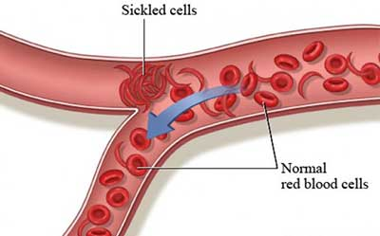
Indications for use
Opioid-dependent nonsurgical patients
Sickle cell disease
Uprety D, Baber A, Foy M. Ketamine infusion for sickle cell pain crisis refractory to opioids: a case report and review of literature. Ann Hematol.2014

Slide 20
Indications for use
Obstructive sleep apnea (OSA)
Opioids increase the severity of OSA syndrome after surgery
Its effect on the incidence of respiratory depression is less clear because high-level evidence is lacking for ketamine in the sleep apnea population
Schwenk, E. et al. (2018). Consensus Guidelines on the Use of Intravenous Ketamine Infusions for Acute Pain Management From the American Society of Regional Anesthesia and Pain Medicine, the American Academy of Pain Medicine, and the American Society of Anesthesiologists. Regional Anesthesia And Pain Medicine

Slide 21
Indications for use
Subanesthetic ketamine infusions should be considered for patients undergoing painful surgery
grade B recommendation, moderate level of certainty
Schwenk, E. et al. (2018). Consensus Guidelines on the Use of Intravenous Ketamine Infusions for Acute Pain Management From the American Society of Regional Anesthesia and Pain Medicine, the American Academy of Pain Medicine, and the American Society of Anesthesiologists. Regional Anesthesia And Pain Medicine

Slide 22
Indications for use
Ketamine may be considered for opioid-dependent or opioidtolerant patients undergoing surgery
grade B recommendation,low level of certainty
Schwenk, E. et al. (2018). Consensus Guidelines on the Use of Intravenous Ketamine Infusions for Acute Pain Management From the American Society of Regional Anesthesia and Pain Medicine, the American Academy of Pain Medicine, and the American Society of Anesthesiologists. Regional Anesthesia And Pain Medicine

Slide 23
Indications for use
Ketamine may be considered for opioid dependent
or opioid-tolerant patients with acute or chronic
sickle cell pain
grade C recommendation, low level of certainty
Schwenk, E. et al. (2018). Consensus Guidelines on the Use of Intravenous Ketamine Infusions for Acute Pain Management From the American Society of Regional Anesthesia and Pain Medicine, the American Academy of Pain Medicine, and the American Society of Anesthesiologists. Regional Anesthesia And Pain Medicine

Slide 24
Indications for use
ketamine may be considered as an adjunct to limit opioids in patients with OSA
grade C recommendation, low level of certainty
Schwenk, E. et al. (2018). Consensus Guidelines on the Use of Intravenous Ketamine Infusions for Acute Pain Management From the American Society of Regional Anesthesia and Pain Medicine, the American Academy of Pain Medicine, and the American Society of Anesthesiologists. Regional Anesthesia And Pain Medicine

Slide 25
What Dose Range Is Considered Subanesthetic, and Does the Evidence Support Dosing in This Range for Acute Pain?

Slide 26
Subanesthetic dosing range
anesthetic induction dose by FDA
1 to 4.5 mg/kg (average dose 2 mg/kg)
Schwenk, E. et al. (2018). Consensus Guidelines on the Use of Intravenous Ketamine Infusions for Acute Pain Management From the American Society of Regional Anesthesia and Pain Medicine, the American Academy of Pain Medicine, and the American Society of Anesthesiologists. Regional Anesthesia And Pain Medicine

Slide 27
Ketamine low-dose continuous infusion rate of 0.06 to 0.30 mg/kg per hour
Reductions in opioid consumption

Slide 28
Meta-analysis of 14 randomized trials , 649 patients
Subanesthetic ketamine decrease pain scores and postoperative morphine consumption for up 24 hours following spine surgery
Bolus doses 0.15 to 10 mg/kg
infusion rates 0.06 to 5.0 mg/kg per hour

Slide 29
Subanesthetic dosing range
The analgesic effects induced by subanesthetic ketamine are reflected by objective measures
Functional imaging
Schwenk, E. et al. (2018). Consensus Guidelines on the Use of Intravenous Ketamine Infusions for Acute Pain Management From the American Society of Regional Anesthesia and Pain Medicine, the American Academy of Pain Medicine, and the American Society of Anesthesiologists. Regional Anesthesia And Pain Medicine

Slide 31
Rogers R, Wise RG, Painter DJ, et al. An investigation to dissociate the analgesic and anesthetic properties of ketamine using functional magnetic resonance imaging. Anesthesiology. 2004

Slide 33
Niesters M, Khalili-Mahani N, Martini C, et al. Effect of subanesthetic ketamine on intrinsic functional brain connectivity: a placebo-controlled functional magnetic resonance imaging study in healthy male volunteers. Anesthesiology. 2012

Slide 34
Subanesthetic dosing range
Bolus doses do not exceed 0.35 mg/kg
Infusion rate do not exceed 1 mg/kg per hour
in settings without intensive monitoring
Schwenk, E. et al. (2018). Consensus Guidelines on the Use of Intravenous Ketamine Infusions for Acute Pain Management From the American Society of Regional Anesthesia and Pain Medicine, the American Academy of Pain Medicine, and the American Society of Anesthesiologists. Regional Anesthesia And Pain Medicine
Notes:
but we also acknowledge that individual pharmacokinetic
and pharmacodynamic differences, as well as other
factors (eg, prior ketamine exposure), may warrant dosing outside
this range

Slide 35
Subanesthetic dosing range
Lower doses (ie, 0.1–0.5mg/kg per hour) may be needed to achieve an adequate balance of analgesia and adverse effects
grade C recommendation, moderate level of certainty
Schwenk, E. et al. (2018). Consensus Guidelines on the Use of Intravenous Ketamine Infusions for Acute Pain Management From the American Society of Regional Anesthesia and Pain Medicine, the American Academy of Pain Medicine, and the American Society of Anesthesiologists. Regional Anesthesia And Pain Medicine
Notes:
but we also acknowledge that individual pharmacokinetic
and pharmacodynamic differences, as well as other
factors (eg, prior ketamine exposure), may warrant dosing outside
this range

Slide 36
What Is the Evidence to Support Ketamine Infusions as an Adjunct to Opioids and Other Analgesic Therapies for Perioperative Analgesia?

Slide 37
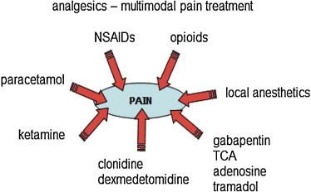

Slide 38
Schwenk, E. et al. (2018). Consensus Guidelines on the Use of Intravenous Ketamine Infusions for Acute Pain Management From the American Society of Regional Anesthesia and Pain Medicine, the American Academy of Pain Medicine, and the American Society of Anesthesiologists. Regional Anesthesia And Pain Medicine
Notes:
The addition of ketamine was associated with a small but significant reduction in pain scores, a moderate decrease in the requirement of opioids in all 4 meta-analyses, and a lower incidence of postoperative nausea and vomiting during
the initial postoperative period in 3 of the reviews.2,42,43 None of the 4 meta-analyses reported increased sedation with use of ketamine,
and only one found an increase in neuropsychiatric adverse
effects of ketamine (eg, hallucinations, nightmares).2

Slide 39
Nesher N, Ekstein MP, Paz Y, et al. Morphine with adjuvant ketamine vs higher dose of morphine alone for immediate post thoracotomy analgesia. Chest. 2009

Slide 40
Adjunctive Therapies for Perioperative Analgesia
Moderate evidence supports use of subanesthetic IV ketamine bolus doses (up to 0.35 mg/kg) and infusions (up to 1 mg/kg per hour) as adjuncts to opioids for perioperative analgesia
Grade B recommendation, moderate level of certainty
Schwenk, E. et al. (2018). Consensus Guidelines on the Use of Intravenous Ketamine Infusions for Acute Pain Management From the American Society of Regional Anesthesia and Pain Medicine, the American Academy of Pain Medicine, and the American Society of Anesthesiologists. Regional Anesthesia And Pain Medicine

Slide 41
What Are the Contraindications to Ketamine Infusions in the Setting of Acute Pain Management, and Do They Differ From Chronic Pain Settings?

Slide 42
Schwenk, E. et al. (2018). Consensus Guidelines on the Use of Intravenous Ketamine Infusions for Acute Pain Management From the American Society of Regional Anesthesia and Pain Medicine, the American Academy of Pain Medicine, and the American Society of Anesthesiologists. Regional Anesthesia And Pain Medicine
Notes:
Evidence indicates that ketamine should be avoided in individuals with poorly controlled cardiovascular disease (grade C evidence, moderate level of certainty) and pregnancy or active psychosis (grade B evidence, moderate level
of certainty). For hepatic dysfunction, evidence supports that ketamine infusions should be avoided in individuals with severe disease (eg, cirrhosis) and used with caution (ie, with monitoring of liver function tests before infusion
and during infusions in surveillance of elevations) in individuals with moderate disease (grade C evidence, low level of certainty). Evidence indicates that ketamine should be avoided in individuals with elevated intracranial pressure
and elevated intraocular pressure (grade C evidence, low level of certainty). Relative contraindications are shown in Table 5.

Slide 43
What Is the Evidence to Support Nonparenteral Ketamine for Acute Pain Management?

Slide 44
Nonparenteral Ketamine for Acute Pain
no FDA-approved nonparenteral formulations exist for oral or intranasal (IN) administration
oral or IN ketamine administration have involved off-label use
Schwenk, E. et al. (2018). Consensus Guidelines on the Use of Intravenous Ketamine Infusions for Acute Pain Management From the American Society of Regional Anesthesia and Pain Medicine, the American Academy of Pain Medicine, and the American Society of Anesthesiologists. Regional Anesthesia And Pain Medicine

Slide 45
Rigo FK, Trevisan G, Godoy MC, et al. Management of neuropathic chronic pain with methadone combined with ketamine: a randomized, double blind, active-controlled clinical trial. Pain Physician. 2017
Notes:
42 patients with chronic neuropathic pain randomized to oral ketamine 30 mg 3 times per day, oral methadone 3 mg 3 times per day, or the same doses of both drugs, the ketamine group experienced greater pain relief after 3 months of therapy compared with the other groups.64

Slide 46
Notes:
A recent pilot study involving
3 patients who received 0.5 to 1 mg/kg of oral ketamine 3 times
per day also suggests effectiveness for acute postoperative
amputation pain

Slide 51
Nonparenteral Ketamine for Acute Pain
IN ketamine
benefit for acute pain management, not only effective analgesia but also amnesia and procedural sedation
gradeC recommendation, low-to-moderate level of certainty
Schwenk, E. et al. (2018). Consensus Guidelines on the Use of Intravenous Ketamine Infusions for Acute Pain Management From the American Society of Regional Anesthesia and Pain Medicine, the American Academy of Pain Medicine, and the American Society of Anesthesiologists. Regional Anesthesia And Pain Medicine
Notes:
Particular scenarios in which this should be considered include individuals for whom IVaccess is difficult and children undergoing procedures

Slide 52
Nonparenteral Ketamine for Acute Pain
Oral ketamine
the evidence is less robust, but small studies and anecdotal reports suggest it may provide short-term benefit in some individuals with acute pain
grade C recommendation, low level of certainty
Schwenk, E. et al. (2018). Consensus Guidelines on the Use of Intravenous Ketamine Infusions for Acute Pain Management From the American Society of Regional Anesthesia and Pain Medicine, the American Academy of Pain Medicine, and the American Society of Anesthesiologists. Regional Anesthesia And Pain Medicine
Notes:
Particular scenarios in which this should be considered include individuals for whom IVaccess is difficult and children undergoing procedures

Slide 53
Does Any Evidence Support Patient-Controlled IV Ketamine Analgesia for Acute Pain?

Slide 54
Patient-Controlled IV Ketamine Analgesia for Acute Pain
Intravenous PCA is a common manner of medication delivery in acute medical and postoperative pain settings
Opioid medications are the most common analgesic medication
ketamine has also been used in IV-PCA
Schwenk, E. et al. (2018). Consensus Guidelines on the Use of Intravenous Ketamine Infusions for Acute Pain Management From the American Society of Regional Anesthesia and Pain Medicine, the American Academy of Pain Medicine, and the American Society of Anesthesiologists. Regional Anesthesia And Pain Medicine

Slide 55
Sole IV-PCA analgesic
Cohen SP, DeJesus M. Ketamine patient-controlled analgesia for dysesthetic central pain. Spinal Cord. 2004

Slide 56
Sole IV-PCA analgesic
Taylor M, Jakacki R, May C, Howrie D, Maurer S. Ketamine PCA for treatment of end-of-life neuropathic pain in pediatrics. Am J Hosp Palliat Care. 2015

Slide 57
Sole IV-PCA analgesic
MacPherson RD, Woods D, Penfold J. Ketamine and midazolam delivered by patient-controlled analgesia in relieving pain associated with burns dressings. Clin J Pain. 2008

Slide 58
combination with opioids PCA
Wang L, Johnston B, Kaushal A, Cheng D, Zhu F, Martin J. Ketamine added to morphine or hydromorphone patient-controlled analgesia for acute postoperative pain in adults: a systematic review and meta-analysisof randomized trials. Can J Anaesth. 2016

Slide 59
Wang L, Johnston B, Kaushal A, Cheng D, Zhu F, Martin J. Ketamine added to morphine or hydromorphone patient-controlled analgesia for acute postoperative pain in adults: a systematic review and meta-analysisof randomized trials. Can J Anaesth. 2016

Slide 60
combination with opioids PCA
Assouline B, Tramèr MR, Kreienbühl L, Elia N. Benefit and harm of adding ketamine to an opioid in a patient-controlled analgesia device for
the control of postoperative pain: systematic review and meta-analyses of randomized controlled trials with trial sequential analyses. Pain. 2016;

Slide 61
Assouline B, Tramèr MR, Kreienbühl L, Elia N. Benefit and harm of adding ketamine to an opioid in a patient-controlled analgesia device for the control of postoperative pain: systematic review and meta-analyses of randomized controlled trials with trial sequential analyses. Pain. 2016;

Slide 62
Patient-Controlled IV Ketamine Analgesia for Acute Pain
evidence is limited for the benefit of IV-PCA–delivered ketamine as the sole analgesic for acute or periprocedural pain
grade C recommendation, low level of certainty
Schwenk, E. et al. (2018). Consensus Guidelines on the Use of Intravenous Ketamine Infusions for Acute Pain Management From the American Society of Regional Anesthesia and Pain Medicine, the American Academy of Pain Medicine, and the American Society of Anesthesiologists. Regional Anesthesia And Pain Medicine

Slide 63
Patient-Controlled IV Ketamine Analgesia for Acute Pain
moderate evidence supports the benefit of the addition of ketamine to an opioid based IV-PCA for acute and perioperative pain management
grade B recommendation, moderate level of certainty
Schwenk, E. et al. (2018). Consensus Guidelines on the Use of Intravenous Ketamine Infusions for Acute Pain Management From the American Society of Regional Anesthesia and Pain Medicine, the American Academy of Pain Medicine, and the American Society of Anesthesiologists. Regional Anesthesia And Pain Medicine

Slide 64
Take home message

Slide 65
Reference
- Schwenk, E. et al. Consensus Guidelines on the Use of Intravenous Ketamine Infusions for Acute Pain Management From the American Society of Regional Anesthesia and Pain Medicine, the American Academy of Pain Medicine, and the American Society of Anesthesiologists. Regional Anesthesia And Pain Medicine . 2018
-Laskowski K, Stirling A, McKay WP, Lim HJ. A systematic review of intravenous ketamine for postoperative analgesia. Can J Anaesth. 2011
-Barreveld AM, Correll DJ, Liu X, et al. Ketamine decreases postoperative pain scores in patients taking opioids for chronic pain: results of a prospective, randomized, double-blind study. Pain Med. 2013
-Uprety D, Baber A, Foy M. Ketamine infusion for sickle cell pain crisis refractory to opioids: a case report and review of literature. Ann Hematol.2014
-Rogers R, Wise RG, Painter DJ, et al. An investigation to dissociate the analgesic and anesthetic properties of ketamine using functional magnetic resonance imaging. Anesthesiology. 2004
-Niesters M, Khalili-Mahani N, Martini C, et al. Effect of subanesthetic ketamine on intrinsic functional brain connectivity: a placebo-controlled functional magnetic resonance imaging study in healthy male volunteers. Anesthesiology. 2012
-Nesher N, Ekstein MP, Paz Y, et al. Morphine with adjuvant ketamine vs higher dose of morphine alone for immediate post thoracotomy analgesia. Chest. 2009
- Assouline B, Tramèr MR, Kreienbühl L, Elia N. Benefit and harm of adding ketamine to an opioid in a patient-controlled analgesia device for the control of postoperative pain: systematic review and meta-analyses of randomized controlled trials with trial sequential analyses. Pain. 2016
-Wang L, Johnston B, Kaushal A, Cheng D, Zhu F, Martin J. Ketamine added to morphine or hydromorphone patient-controlled analgesia for acute postoperative pain in adults: a systematic review and meta-analysisof randomized trials. Can J Anaesth. 2016

Slide 66
Reference
- MacPherson RD, Woods D, Penfold J. Ketamine and midazolam delivered by patient-controlled analgesia in relieving pain associated with burns dressings. Clin J Pain. 2008
- Taylor M, Jakacki R, May C, Howrie D, Maurer S. Ketamine PCA for treatment of end-of-life neuropathic pain in pediatrics. Am J Hosp Palliat Care. 2015
-Cohen SP, DeJesus M. Ketamine patient-controlled analgesia for dysesthetic central pain. Spinal Cord. 2004

